Slide 1
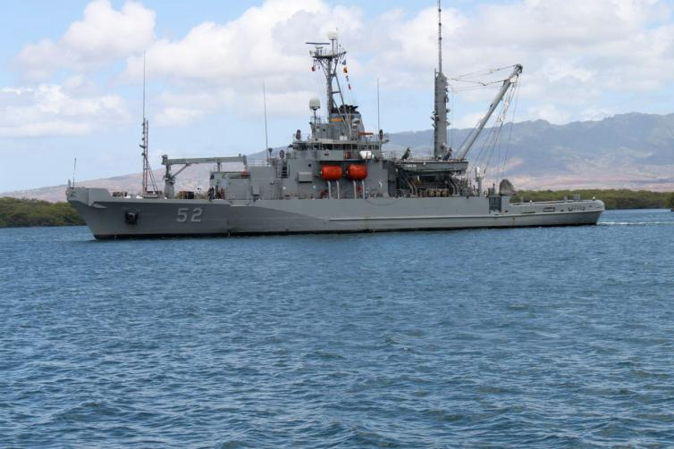
USNS SALVOR

Slide 2
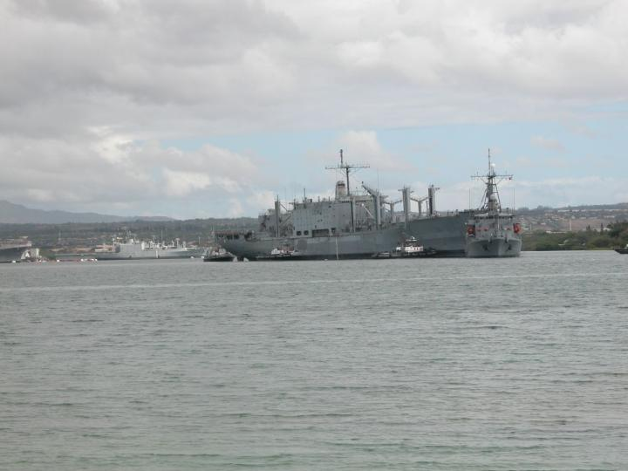
USNS SALVOR SINKEX Tow X-NIAGRA FALLS Photo provided by Bernie Donathan

Slide 3
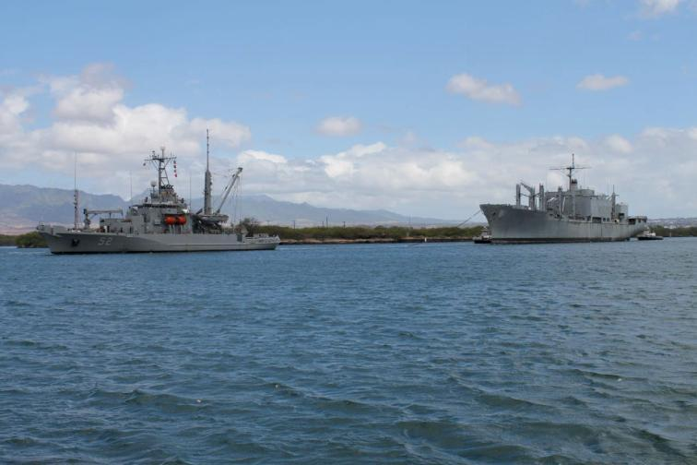
USNS SALVOR SINKEX Tow X-CONCORD Photo provided by PH Pilot Capt Wade Armstrong

Slide 4
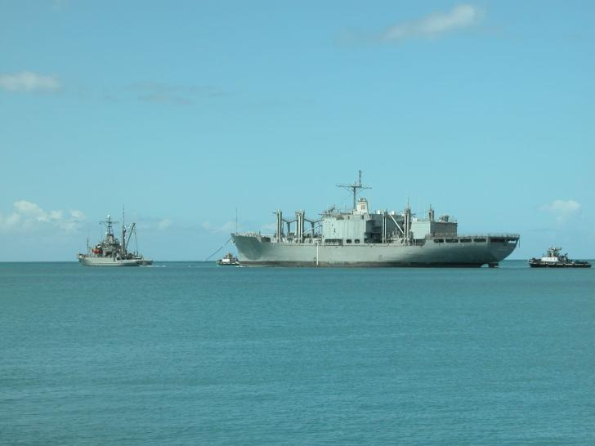
USNS SALVOR SINKEX Tow X-NIAGRA FALLS Photo provided by Bernie Donathan

Slide 5
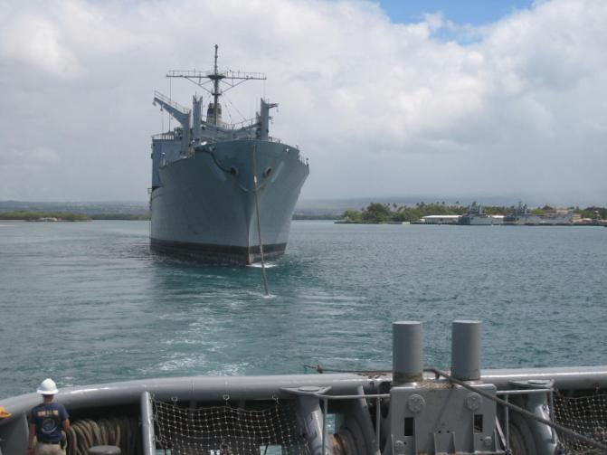
USNS SALVOR SINEX Tow X-CONCORD

Slide 6
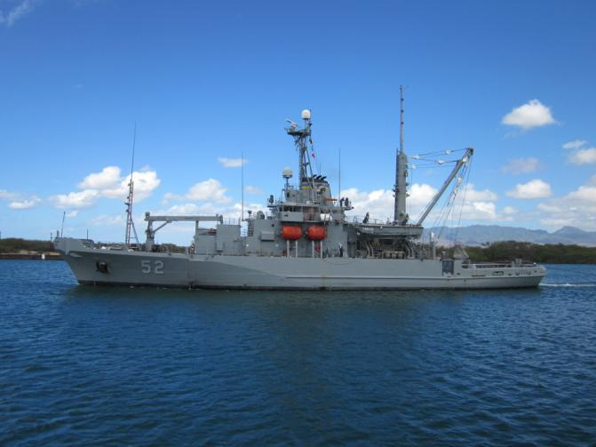
USNS SALVOR Photo by PH Pilot Capt Wade Armstrong

Slide 7
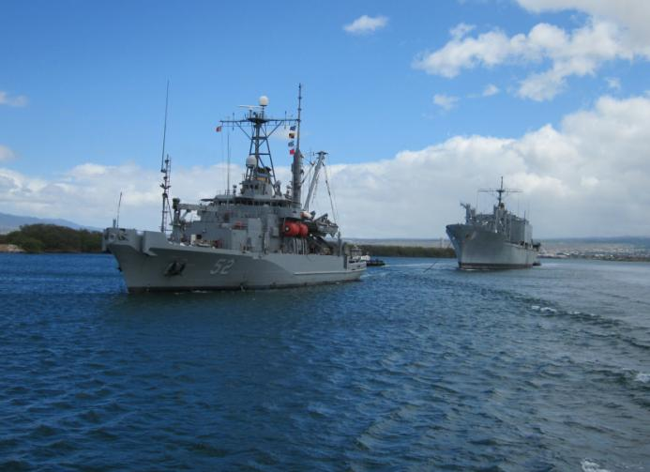
USNS SALVOR SINKEX Tow of X-CONCORD Photo by PH Pilot Capt Wade Armstrong

